Slide 1
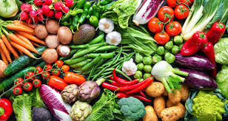
Vegetable’s name
Yasai no namae

Slide 2
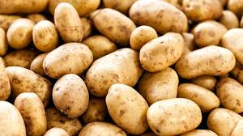
Potato
Jagaimo

Slide 3
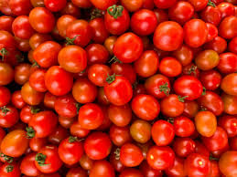
Tomato
Tomato

Slide 4
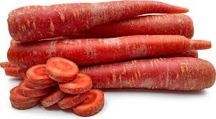
Carrot
Ninjin

Slide 5
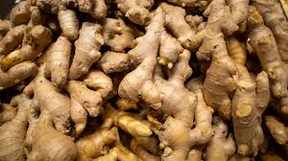
Ginger
Jinjaa

Slide 6
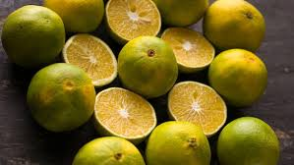
Lemon
Remon

Slide 7
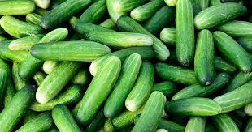
Cucumber
Kyuuri

Slide 8
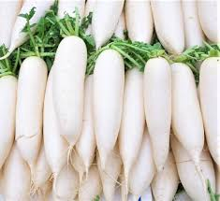
Raddish
Daikon/Radishuu

Slide 9
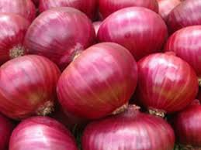
Onion
Tamanegi

Slide 10
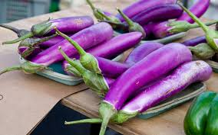
Brinjal
Nasu

